Slide 1

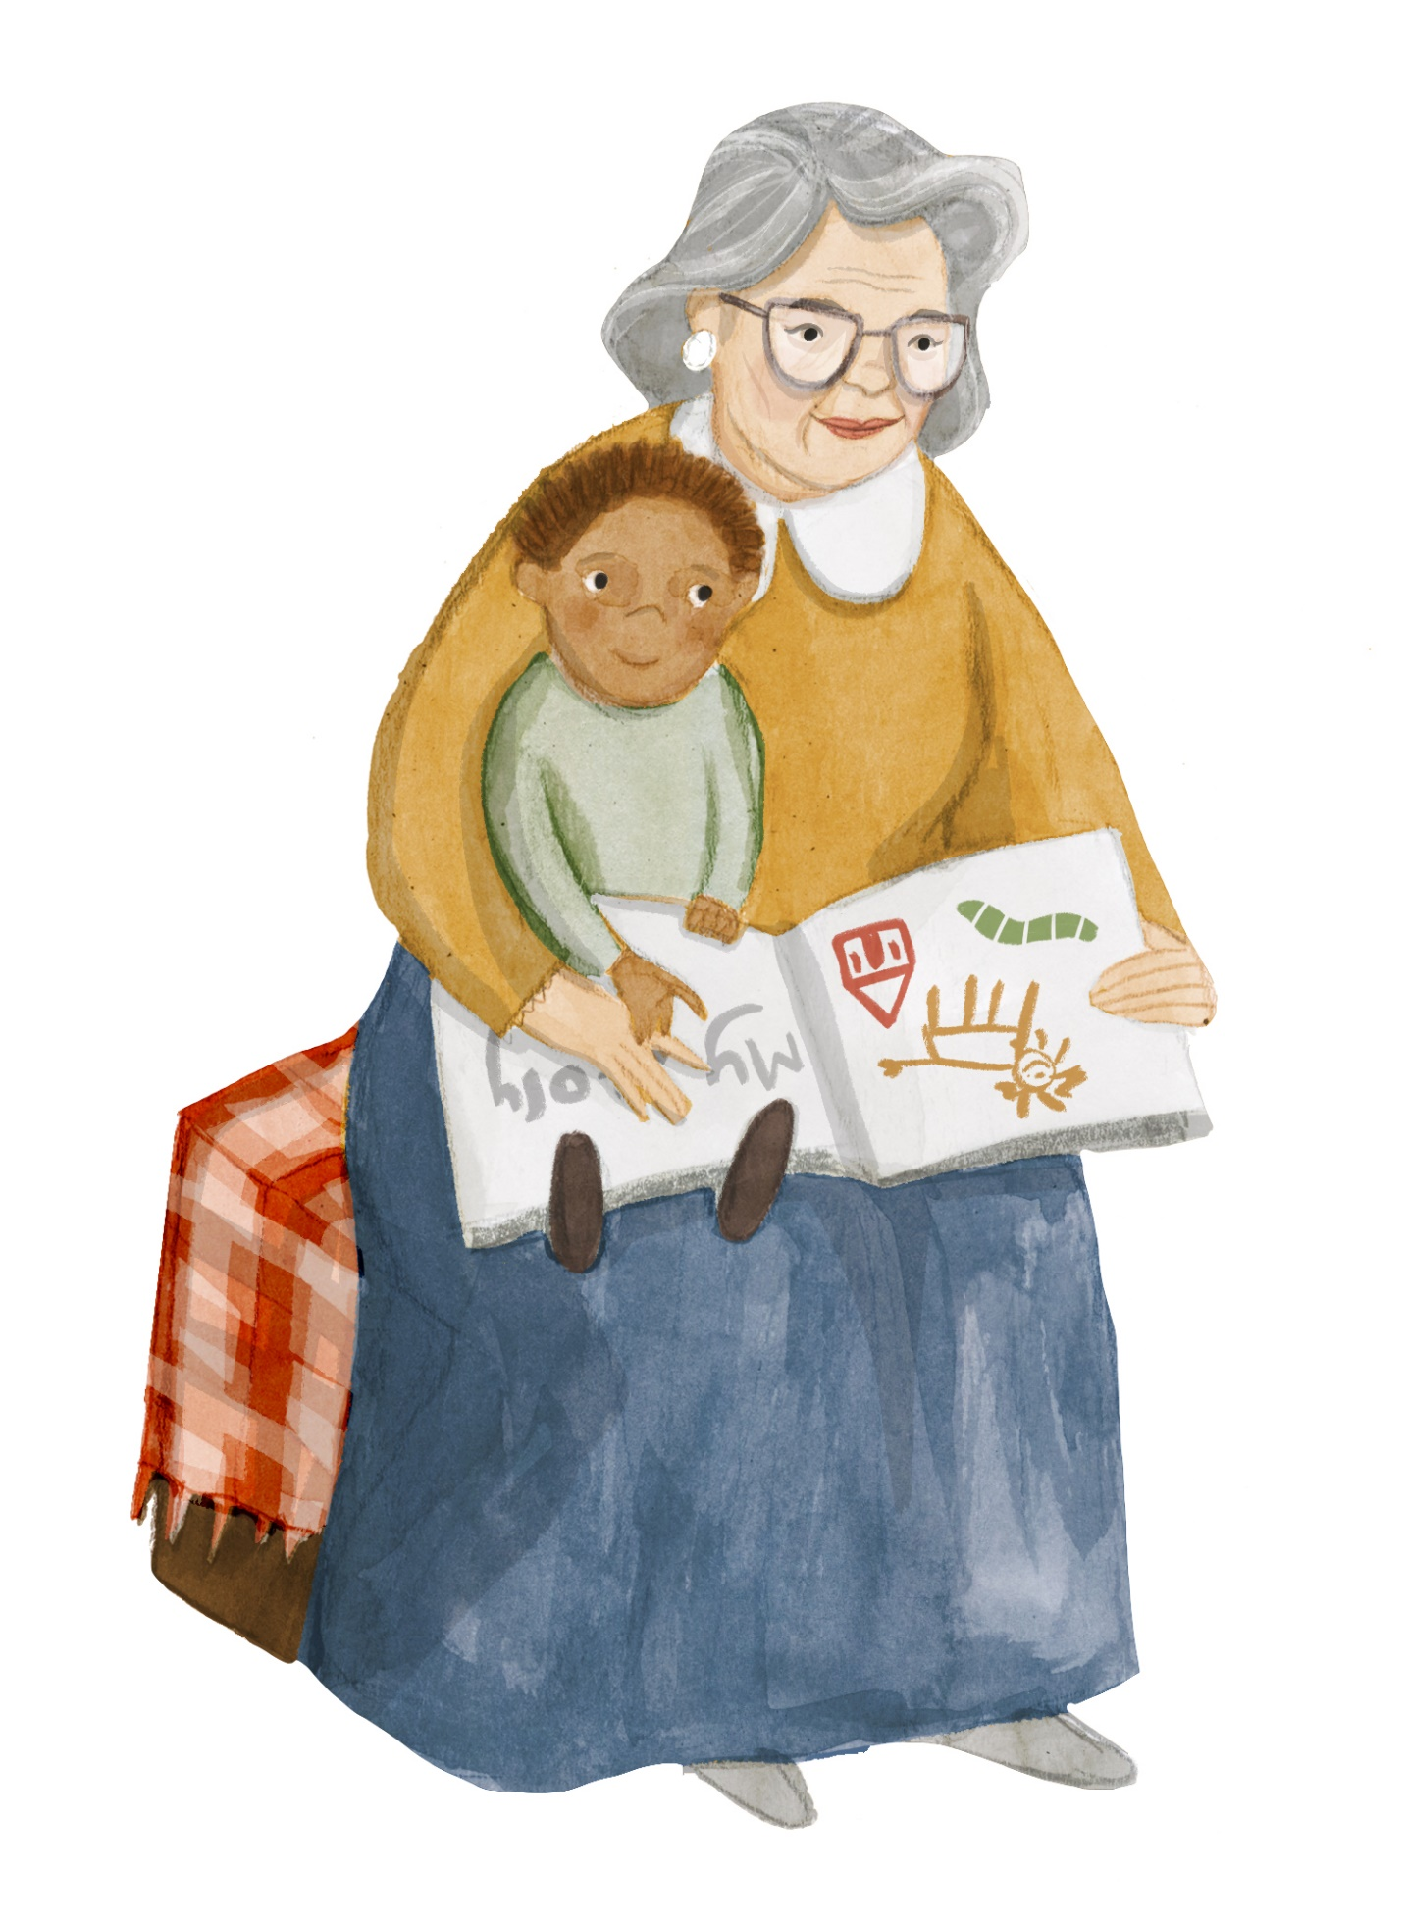


Home and belonging 5
How can we equip ourselves for change?
PSHE

Slide 2

Home and belonging
Session five: PSHE
Learners will be able to:
Compare their lives to the lives of others, in particular children from different eras; recognise their ‘common humanity’ with others
Create strategies for a personal toolkit to support in times of change and new beginnings
Imagine how it feels for others going through change
Design ways to show kindness to others going through change

Slide 3
Key words
Word | Definition | Synonyms
Transition | Passage from one stage, state or place to another | Change
Mental health | “a state of well-being in which the individual realizes his or her own abilities, can cope with the normal stresses of life, can work productively and fruitfully, and is able to make a contribution to his or her community” (WHO) | Wellbeing, flourishing
Empathy | the ability to share someone else’s feelings or experiences by imaging what it would be like to be in their situation
Compassion | concern for the suffering of others and a desire to help

Slide 4
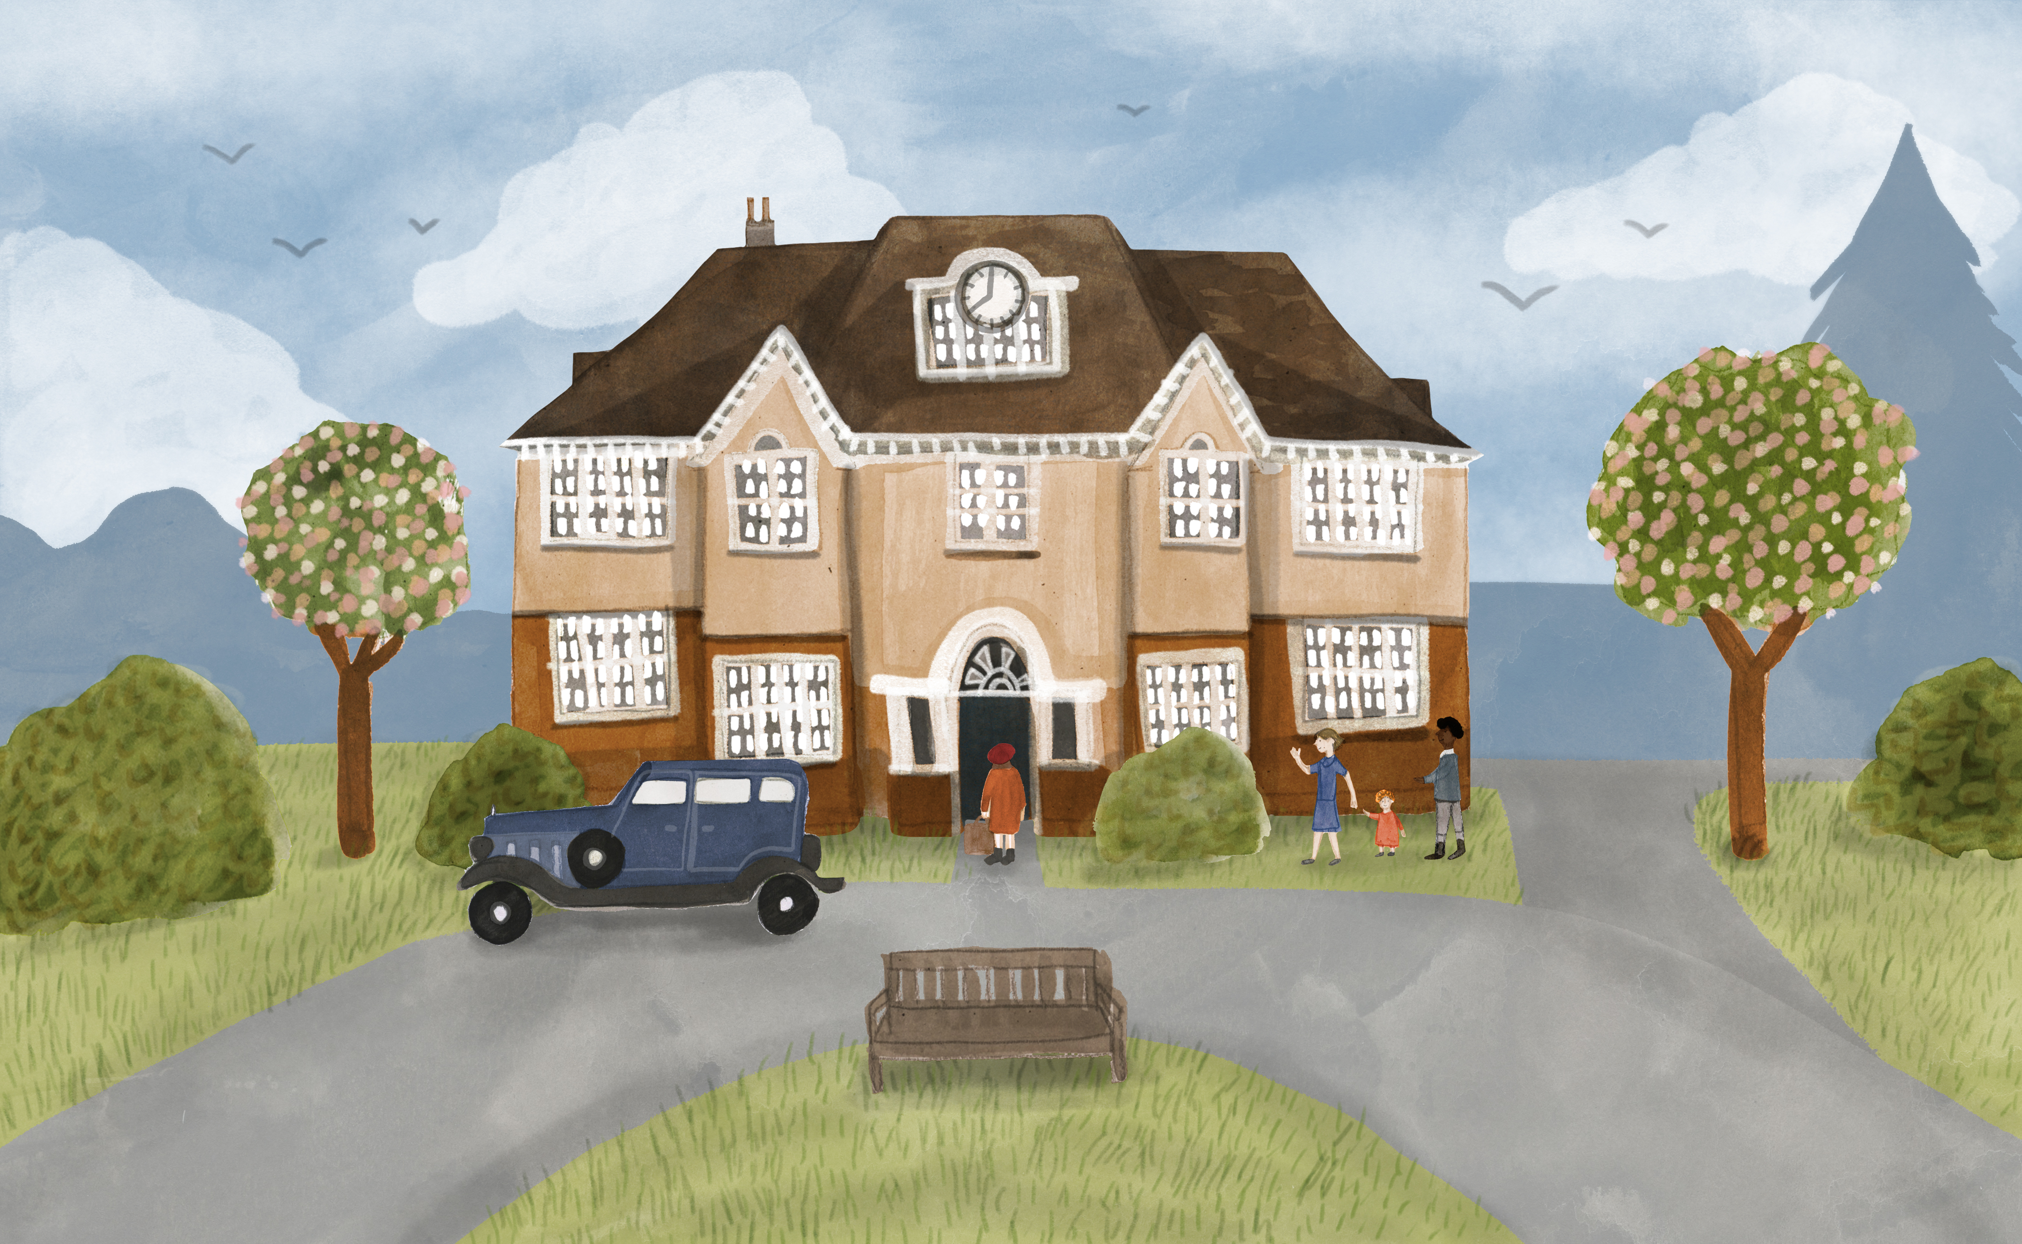
Beginning a new life at Highfield Oval
How do you think these children are feeling?
What clues do we have as to how they are feeling?
What might have helped them to start to feel at home?
What would you want to take with you, if you were on a journey of change?
https://www.youtube.com/watch?v=9brSkv1lWDo
Notes:
Engage activity – approximately 10 minutes
Show the video of children arriving at Highfield Oval, produced in the 1950s and discuss the questions.

Slide 5
How might children have felt as they arrived at Highfield Children’s Home?
Place each feeling on an emotions arrow:
Most negative Most positive
Notes:
Teacher led activity – approximately 10 minutes
As you collect the feelings they think the children are feeling, write each one on a post it note and ask the children to decide where to place the emotion on an emotions arrow (from most negative to most positive). Question why they have chosen that position. Does anyone agree/disagree?

Slide 6
How might children have felt as they arrived at Highfield Children’s Home?
Watch the video:
We All Have Mental Health
How did it make you feel watching this video? Why?
https://www.youtube.com/watch?v=DxIDKZHW3-E
Notes:
Teacher led activity – approximately 10 minutes
Watch video We All have Mental Health
In Talking Trios children discuss the question above, justifying their answers.
Key Questions:
How did it make you feel watching this video? Why?
Discuss the fact that knowing other people are going through similar experiences/emotions as we are can be reassuring and comforting.
Also talk about the fact that because mental health is inside, we need to be extra empathetic to spot when people need help.

Slide 7
When have you been through a big change?
When have you been through a big change or transition in your life?
Which of the feelings on our feelings arrow did you experience?
What helped you manage the transition?
What other changes do children in Harpenden and around the world experience in their lives?
Notes:
Independent activity – approximately 10 minutes
When have you been through a big change in your life?
Which of the feelings on our feelings arrow did you experience?
What helped you to manage the change?
What other changes do children in Harpenden and around the world experience?
Gather ideas of change eg new school, new house, new sibling/pet, new family dynamic (if parents separate or die), new club/ class/ teacher, new country/culture/language (refugees)

Slide 8
Toolkit for change
Create a toolkit for change – full of strategies for embracing change and new beginnings.
You can present your toolkit in any way you choose eg report, poem, cartoon, poster, song.
Notes:
Independent – approximately 30 minutes (slides 8-9)
Each child creates a toolkit for change – full of strategies for embracing change and new beginnings.
Children can present their toolkit in any way they choose eg report, poem, cartoon, poster, song.
Share ideas before and during the activity eg mindfulness, deep breathing, positive affirmations, gratitude diary, fresh air, being active, doing something your love, talking to someone, doing something for someone else, telling a joke/laughing etc
Stop to share Five Ways to Wellbeing part way through – see slide 9

Slide 9

How many of the Five Ways to Wellbeing does your toolkit include?
Notes:
Independent – approximately 30 minutes (slides 8-9)
Check in with children part way through to see how many of the Five Ways to Wellbeing they have included in their toolkit. Ask children for their own examples of each of the Five ways of Wellbeing in their toolkits. Are there any more they would like to add having heard each other’s ideas?
For more information on Five Ways to Wellbeing: https://www.gov.uk/government/publications/five-ways-to-mental-wellbeing

Slide 10
Which of these quotes most resonates with you? Why?
To bring about change,
you must not be afraid to take the first step. We will fail when we fail to try.
Rosa Parks
"Look on every exit as being an entrance somewhere else."
Tom Stoppard.
“When we are no longer able to change a situation - we are challenged to change ourselves.”
Viktor E Frankl
Notes:
Reflection – approximately 15 minutes (slides 10 – 14)
Which quote most resonates with you? Why?

Slide 11
Which of these quotes most resonates with you? Why?
To bring about change,
you must not be afraid to take the first step. We will fail when we fail to try.
Rosa Parks
Rosa Parks was arrested in Alabama, USA in 1955, for refusing to give up her seat to a white man, when the law said that as a black woman she had to sit at the back of the bus. Her resistance helped spark the American civil rights movement.

Slide 12
Which of these quotes most resonates with you? Why?
"Look on every exit as being an entrance somewhere else."
Tom Stoppard
Tom Stoppard is a playwright whose play Rosencrantz and Guildenstern are Dead concerns the mishaps of two minor characters from Shakespeare’s Hamlet.

Slide 13
Which of these quotes most resonates with you? Why?
“When we are no longer able to change a situation - we are challenged to change ourselves.”
Viktor E Frankl
Viktor E Frankl (1905-1997) wrote Man’s Search for Meaning, about life purpose and resilience, based on his experience in a Nazi concentration camp during World War II.

Slide 14
Reflection
Can you create your own quote about change that could help someone else going through a challenging period of change?
What other acts of kindness or compassion could you show someone going through a period of change?
Notes:
Can you create your own quote about change that could help someone else going through a challenging period of change?
What other acts of kindness could you show someone going through a period of change or a new beginning?

