Slide 1

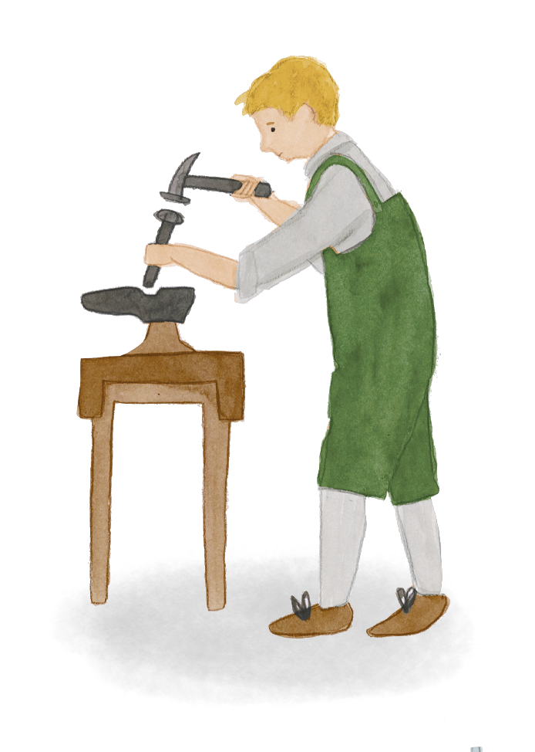


Home and belonging 3
To what extent did the vision become reality at Highfield Oval?
(photographs)
HISTORY

Slide 2

Learning objectives
Learners will be able to:
Apply a three step framework as they interpret photographs: observe, reflect, question
Use photographic sources as historical evidence, taking into account the perspective and purpose of the producer and the context
Explain that no single source of evidence gives the full answer to questions about the past and it is important to cross-reference evidence

Slide 3
Key words
Key concepts | Definition | Synonyms
Vision | A description or picture of what a person or organisation wants to be or achieve in the future.
Founder | Someone who sets up an organisation
Historical source | Something that tells us about the past and can be used by a historian to provide evidence. Documents, pictures, sound recordings, books, films, television programmes, objects or buildings can all be historical sources
Primary source | A source which was written or made in the time period being studied
Secondary source | A source which was written or made after the time period being studied, by someone who did not have first hand experience, by interpreting primary sources
Interpret | describe, analyse, evaluate, and create an explanation of past events
Archives | a collection of historical documents or records providing information about a place, organisation or group of people
Cross-reference | To check a finding by looking at further evidence | Confirm, back up
Perspective | A particular way of looking at or thinking about something, especially one that is influenced by your experiences or beliefs | Point of view

Slide 4
Fact or opinion?
Reverend Thomas Bowman Stephenson was a Methodist Minister.
Reverend Thomas Bowman Stephenson was an exceptional man.
The National Children’s Home now work with over 250,000 children, young people, parents and carers, all over the UK.
The governor’s house was the most striking of all the buildings at Highfield.
Highfield, one of the largest homes run by the National Children’s Home (NCH) was opened in Harpenden in 1913.
Notes:
Engage – approximately 5 minutes
Fact vs opinion games in Learning Trios
Stephenson was a Methodist Minister. FACT
The National Children’s Home now work with over 250,000 children, young people, parents and carers, all over the UK. FACT
Reverend Thomas Bowman Stephenson was an exceptional man. OPINION
Highfield, one of the largest homes run by the National Children’s Home (NCH) was opened in Harpenden in 1913. FACT
The governor’s house was the most striking of all the buildings at Highfield. OPINION.

Slide 5
The founders’ vision
The main purpose of the Sanatorium is to find a happy home life for disadvantaged children, where early and expert attention, cleanliness, and a suitable dietary, an abundance of sunshine and fresh air, graded exercise and sufficient rest, the provision of interesting employments and an Open-air School education, all combine to conquer initial difficulties, to build up physical resistance to disease, and to provide a happy and hopeful outlook for the future, which will be favourable to the development of growing minds.
[….] no small part of the Sanatorium’s undoubted achievements for its constantly changing succession of little people is due to the understanding and self-sacrificing devotion of its Sisters, who make it a real home where children are thought of one at a time, and their individual needs are studied.
EXTRA FROM ‘THE SANATORIUM, NCH PUBLICATION, EARLY 20TH CENTURY
Notes:
Teacher input (slides 5-7) – approximately 15
minutes
Read through and talk about the extract, explaining difficult vocabulary or unfamiliar ideas (eg the Sisters, who were the home’s carers, looking after the children.)
What are the key themes of the vision set by the extract? E.g. happy, healthy, sunshine and fresh air, interesting employments, children treated as individuals.

Slide 6
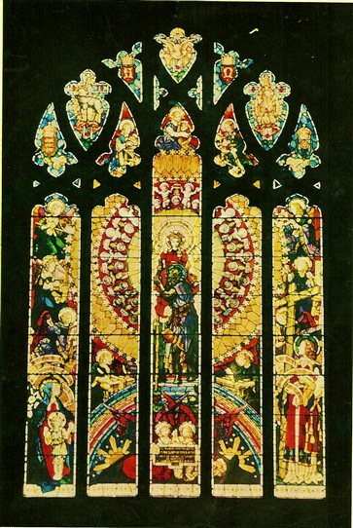
The founders’ vision
What does the chapel window at Highfield Oval tell us about the vision of the people who founded the children’s home?
Notes:
Key features:
(Because of the scale of the photograph it will be necessary to explain some of the these that are not visible.)
Saint Christopher, the patron saint of travellers is shown in the centre, carrying the Christ Child across a river.
The words Truth, Hope, Joy, Peace are on the left and on the right: Alms, Honour, Power, Glory and charity.
Angels are shown engaged in crafts, and skills. They include a painter, a musician, an embroiderer and a writer, a scientist, a stonemason, a chemist and an engineer. (This was intended to represent the trades and skills learnt by the children at Highfield).
The rainbow (a Christian symbol, a sign from God of his covenant with the earth and ‘every living creature’ that the earth would never again be destroyed, as it had been, by flood).
Sunshine
Find out more about the chapel window and the Harpenden artist who designed it here:
http://www.harpenden-history.org.uk/page_id__502.aspx?path=0p3p88p86p

Slide 7
Mind mapping the key themes of the founders’ vision
Theme
Caring
Health
Vision
Kind ‘sisters’
Symbol
Notes:
Together as a class or in groups capture the key themes (eg: health, happiness, learning skills, being outside, a ‘real home’, care etc).
One way to do this would be to create a mind map, which maps out each theme and examples of practical things mentioned in the text or shown in the chapel window which symbolise each theme. (Remind children of their use of symbols in writing about their own homes in the first lesson (PSHE).

Slide 8
To what extent did the vision become reality?
How could we find out, as historians, how far this vision became a reality at Highfield children’s home?
Notes:
Teacher input – approximately 5 minutes
Children discuss and share ideas about how we could find out whether life at the Highfield Children’s Home and sanatorium lived up to the vision eg oral histories (for anyone still alive), photos, paintings, films, diaries, school, records, news reports, council meeting minutes etc
Explain that over the next two sessions the class will be looking at evidence to find out what life was like for the children living at the Highfield Children’s Home and whether or not the founders vision was a reality.
This session will focus on a series of photographs, all provided by Action for Children (as NCH is known today). Typically these photographs were produced for brochures and reports about the home.

Slide 9
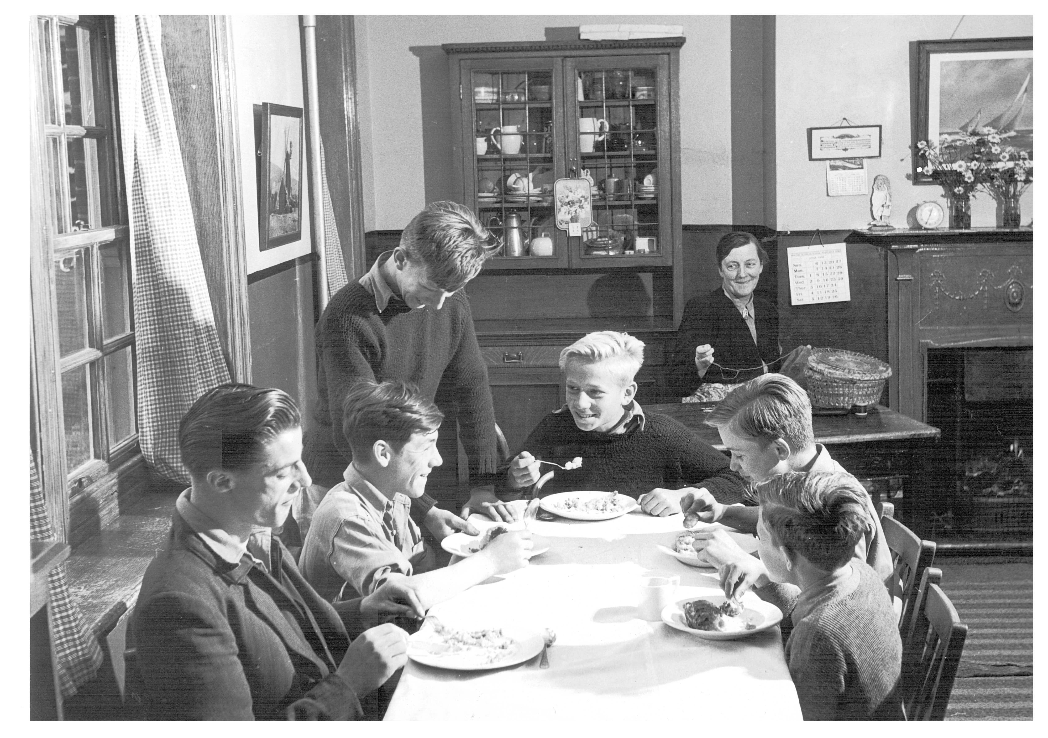
To what extent did vision become reality?
What can this photograph tell us about whether the founders’ vision became reality?
Notes:
Teacher input – approximately 10 minutes
Model the independent activity using the picture of the boys having dinner and the two slides that follow.
Explain that the children will have 30 minutes to select further pictures that they are interested in to analyse and make deductions about the past
The children will need access to the following webpage where the phtographs can be found:
https://wholeheartedchildhood.org.uk/highfield-oval/
Allow the children to choose up to 5 to analyse in depth.
Share findings and ideas at the end.
Allow children time to discuss and debate Who might have taken the photo? Why? is there an alternative perspective? How do we know what is the truth? (discuss the importance of cross-referencing/corroborating evidence as a historian trying to deduce information about the past)

Slide 10
Interpreting photographs
OBSERVE | REFLECT | QUESTION
What do you notice first? What people can you see? (Notice clothes, expressions, activity.) What objects can you see? How are the people/ objects arranged? What is the setting? | How does the photo make you feel? What do the things you can see symbolise to you? What do you think it is saying about life at the children’s home? Why was the photograph taken? Who was the audience? | What is missing from the photo? What do you think happened just before or just after? What are you wondering about?
Notes:
Independent activity – approximately 30 minutes
Children select up to 5 photographs to interpret using the model on slide 10 and complete the table on slide 11.

Slide 11
To what extent did the vision become reality?
SOURCE | DEDUCTIONS | IS THIS TRUE TO THE VISION? | PURPOSE OF THE PRODUCER | IDEAS FOR CROSS-REFERENCING
Photo of boys at dinner | Children had friends Children had fun Like a family home Kind carers | Yes | Could be for a brochure, may want to present positive impression

Slide 12
“The vision for Highfield Oval and the sanatorium was a reality for the children who lived there”
What further evidence or information would you like to ensure the reliability of your conclusion?
Where in the 21st Century are photos used to communicate?
Would you look at them differently after today’s lesson? Why?
Notes:
Reflection – approximately 10 minutes
What further evidence or information would you like to ensure the reliability of your conclusion? Explain that next session the children will be examining written sources of evidence from the Highfield Children’s Home such as diary extracts, poems and minutes from governor meetings
Link to media and social media, especially fake news.

