Slide 1

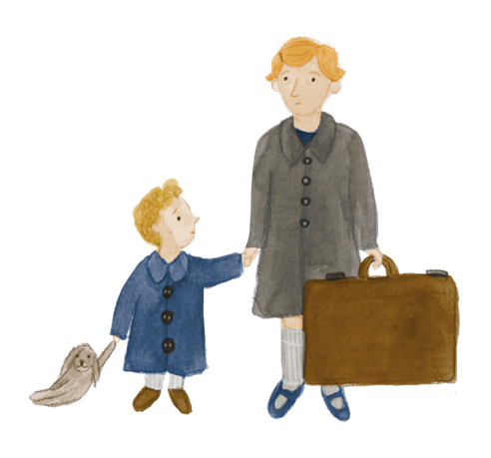


Home and belonging 2 Why is Highfield Oval there at all?
HISTORY

Slide 2

Learning objectives
Learners will be able to:
Describe the people and events which caused the opening of the National Children’s Home in Harpenden, in the context of conditions for disadvantaged children and families in late 19th and early 20th century London
Identify conditions that can make it harder for families to support their children’s wellbeing, now and in the past
Recognise ways in which the support families have received from state and society have changed over time
Identify and explain how the interplay between social conditions and the actions of individuals cause historical change
Use sources of evidence to construct knowledge about the past

Slide 3
Key words
Key concepts | Definition | Synonyms
Welfare | People’s health, comfort and happiness | Wellbeing
Conditions | External factors affecting the way people live or work, for example relating to wealth, health, or housing | Circumstances
Poverty | The condition of having too little money to meet basic needs | Hardship
Sanitation | Conditions affecting public health particularly the provision of clean water and the disposal of sewage | Hygiene
Tuberculosis | A serious, contagious disease that mainly effects the lungs and if untreated can kill
Smog | A yellow or blackish fog that has smoke mixed into it | Air pollution
Slum | An area of run-down, overcrowded housing
Sanatorium | A special type of hospital where people with long term illnesses could be cared for, usually in the countryside so they could benefit from fresh air.
Urban | Relating to a city or town | Metropolitan
Rural | Relating to the countryside

Slide 4
Key words
Key concepts | Definition | Synonyms
Cause | An event, person, or thing that makes something happen
Consequence | The effect of something that happened earlier | Result, outcome
Historical source | Something that tells us about the past and can be used by a historian to provide evidence. Documents, pictures, sound recordings, books, films, television programmes, objects or buildings can all be historical sources
Primary source | A source which was written or made in the time period being studied
Secondary source | A source which was written or made after the time period being studied, by someone who did not have first hand experience, by interpreting primary sources
Corroborate | To support a finding or report with further evidence | Confirm, back up

Slide 5
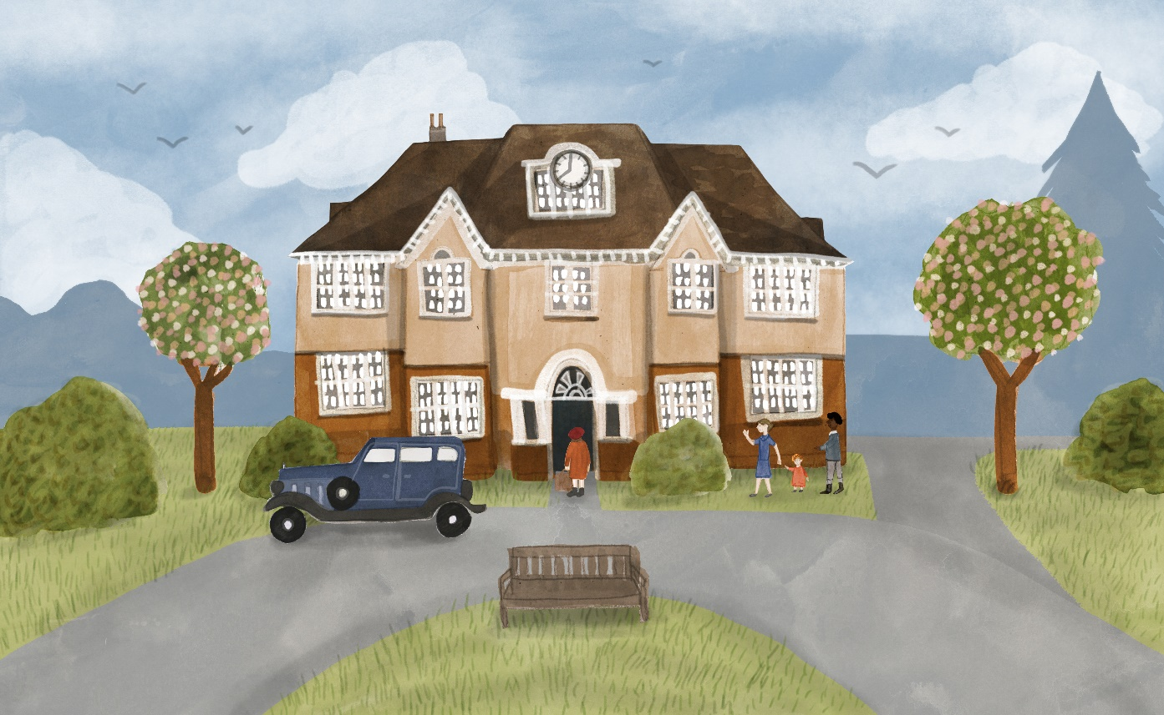
Why is Highfield Oval there at all?
Notes:
Explain that the class is beginning a historical enquiry using a wide range of historical sources to discover the story of Highfield Oval and the reasons it was built in Harpenden over 100 years ago.

Slide 6
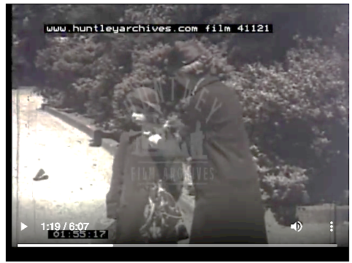
Before and after
What do you think happened just before this scene? Why?
What do you think happened just after this scene? Why?
Notes:
Engage activity – approximately 5 minutes (ideally children to act out before and after outside.)
Show video clip still at 1.19mins– what do you think happened before? After? Why?
https://www.huntleyarchives.com/preview.asp?image=1041121&itemw=4&itemf=0001&itemstep=1&itemx=7

Slide 7
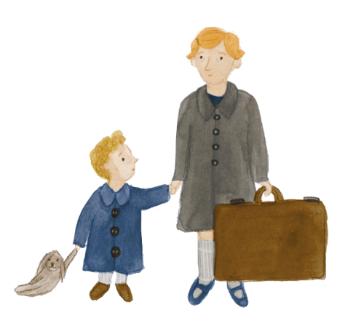
One child’s journey to Highfield Oval
Watch the film of young girl being taken from London slums to Highfield Children’s Home, Harpenden, in the 1930s:
https://www.huntleyarchives.com/preview.asp?image=1041121&itemw=4&itemf=0001&itemstep=1&itemx=7
The film refers to the ‘hundred and one calamities that overwhelm their parents’. What kinds of things do you think this means? What conditions are facing the family in the film?
Notes:
Teacher input – approximately 10 mins
Show video:
https://www.huntleyarchives.com/preview.asp?image=1041121&itemw=4&itemf=0001&itemstep=1&itemx=7
Encourage the class to identify the ‘hundred and one calamities’ - conditions that made it hard for the child’s family to ensure the girl’s wellbeing, such as: the mother’s ill health, overcrowded housing, poverty, pollution (“little fresh air”).
Gather ideas on whiteboard/sugar paper to be displayed throughout session. Ask each child to make their own note of the conditions identified on their worksheet 1.
Explain that Highfield Oval was opened in 1913 by the National Children’s Home and Orphanage (NCH, now Action for Children) The girl is shown arriving first at NCH Sanatorium (now The King’s School) in Ambrose Lane, which once treated children with tuberculosis. She is later taken to live at the children’s home at Highfield Oval.
How do you think the girl might have felt about her journey?
Explain that to understand the history of Highfield Oval it helps to go back further in time to the Victorian Era, when the National Children’s Home began.

Slide 8

What conditions led to a wave of new children’s homes in the late 19th and early 20th century?
As historians, what sources can we use to we find out about the conditions for poor children that contributed to the opening of children’s homes in the late 19th and early 20th century?
Which are primary and which are secondary sources of evidence?
What makes a source reliable?
Notes:
Teacher input – approximately 5 minutes
As historians, how could we find out more about the conditions for children in Victorian London?
Gather ideas on whiteboard/sugar paper to be displayed throughout session:
eg maps, paintings, photos, paintings, films, diaries, written records, newspapers, books, TV programmes etc
Explain that these are all sources of evidence. Which are primary and which are secondary sources of evidence?
What makes a source reliable? (This question will be revisited in future sessions in greater depth.)
Explain that we will be examining and interpreting a range of primary and secondary sources of evidence to understand why Highfield Oval was built and to explore what life was like for the children who lived there.

Slide 9
Working with sources to answer historical questions
When looking at individual sources, think about:
What conditions does the source show children faced at the time?
Why might this have led charities, church groups and other reformers to open children’s homes?
What else would you like to know?
Use worksheet 1 to capture your historical evidence of the conditions that might have led charities and other groups to set up children’s homes.
Notes:
Teacher input – approximately 30 minutes (slides 9 – 15)
As historians, we will now use a range of evidence to answer the question why the National Children’s Home and many other children’s homes and charities were set up at the end of the Victorian era; deducing information about how the Industrial Revolution changed family life, the environment and the way people lived in Victorian times, leading to a need to move children away from London and into Children’s Homes in the countryside.
Discuss what the following photos, extracts and video tell us. What clues are there that these children are not thriving physically or emotionally? (facial expressions, state of clothes etc)
Unless stated otherwise, all photos are from the Action for Children archives.

Slide 10
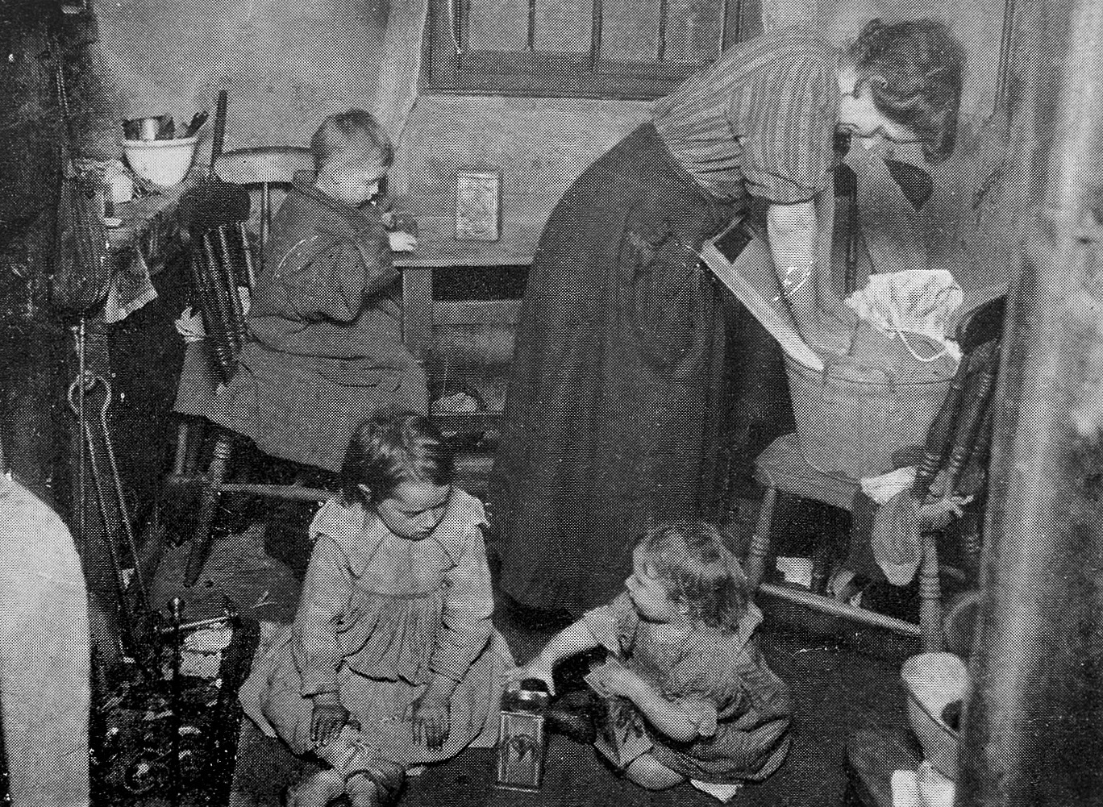
What conditions led to a wave of new children’s homes in the late 19th and early 20th century?
A mother and three children in a slum dwelling,
Wellcome Collection, CC by 4.0 (print 3)

Slide 11
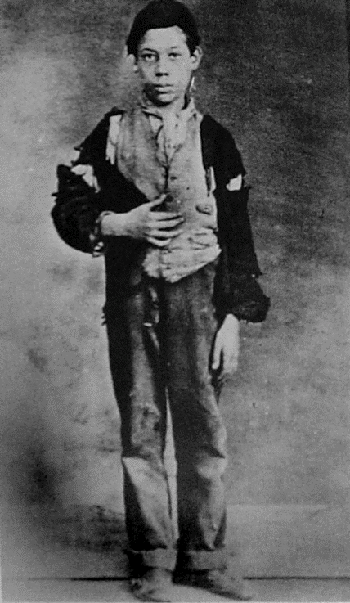
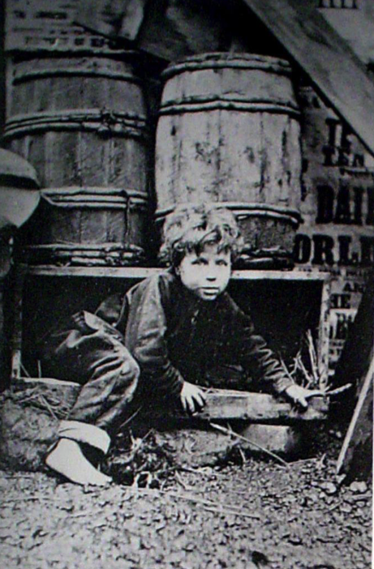
What conditions led to a wave of new children’s homes in the late 19th and early 20th century?
Homeless boys in London 1869, Action for Children (print 1 and 2)

Slide 12
What conditions led to a wave of new children’s homes in the late 19th and early 20th century?
‘The entrance of this boy to the Home was a sight to be remembered; his raggedness was simply indescribable, and he looked as though he had never been washed from the time he was born.
“How did you pick up a living, Harry?”
”Selling matches sir.”
[….] he had a home of a kind, to which he was expected to bring fourpence every night, excepting Sunday, when he had to bring two shillings. Failing this he had to spend the night in the streets, into which, if he dared to return without the money, he was brutally kicked like a dog.”
Extract from New Zealand Methodist journal, reproduced in The Life of the Reverend Thomas Bowman Stephenson, William Bradfield, 1913

Slide 13
What conditions led to a wave of new children’s homes in the late 19th and early 20th century?
Meeting children's needs
The following cases are illustrative of the work done at the branch for the children of need:-
Girl of 11. One of six orphan children living with a married sister who cannot afford to keep them. Boy of 12. Father, of bad character, Mother left with seven children. Girl of 12. Father dead. Mother left with six children under fourteen. Boy of 14. Father and mother died of consumption. Boy needs care and training. Girl of 13. Mother in prison for neglecting child. Boys of 7 and 10. Father died four years ago leaving widow with four boys. Mother cannot get work as she is suffering with lupus in the face.
EXTRACT FROM ‘HIGHWAYS AND HEDGES’ NCH JOURNAL, 1915, PROVIDING AN UPDATE ON THE NEW HARPENDEN CHILDREN’S HOME AND DESCRIBING THE BACKGROUNDS OF THE CHILDREN.

Slide 14
What conditions led to a wave of new children’s homes in the late 19th and early 20th century?
This information about life for the poor in Victorian London was sourced from Museum of London, Science Museum and BBC publications. Which of these factors do you think were the most important in explaining the need for new children’s homes during this period? Why?
Many people died young due to poor health care, pollution and disease. There was no National Health Service. | Very poor people lived in filthy, overcrowded slums. Several families shared one house and an outside toilet. | There were many large industries, such as shipbuilding, and many factories and workshops. | Many people came to London looking for work. By the end of the 19th century London was five times bigger than at the start.
Employers were able to pay very low wages because there were lots of people desperate for work. | There was very little financial support (money) from the Government to help families in poverty. | The smoke from the factories – and from people’s homes, steam boats and steam engines – polluted the air. | Help for those in extreme poverty was mainly through workhouses, giving food and shelter in return for hard work in harsh conditions.
Notes:
Optional extension activity – Diamond Nine (approximately 10 minutes)
This information could be the focus of a Diamond Ranking exercise, in which each cell of the table is cut into an individual card and pupils rank their importance by placing the card with the most important factor in top place, the next two most important on the next level down, then the next three, then two then one, to create a diamond shape. If using this exercise create a ninth blank card, which pupils can use to add a factor that they think was important but is not shown here.
http://www.acewild.eu/wp-content/uploads/2016/10/diamond-ranking-tool-d-1.pdf
Ask learners to explain and justify their ranking.

Slide 15
What conditions led to a wave of new children’s homes in the late 19th and early 20th century?
Watch the Industrial Revolution video:
How does this video corroborate what we have already deduced?
What new reasons could we add?
https://www.youtube.com/watch?v=Xh_Lk7kDrUI

Slide 16
Why were some children’s homes moved out of London to rural areas like Harpenden?
This is a natural pause in the session if you would rather teach it in two parts:
Part 1 – slides 1 – 15
What conditions led to a wave of new children’s homes in the late 19th and early 20th century?
Part 2 – slides 16 – 24
Why were some children’s homes moved out of London to rural areas like Harpenden?

Slide 17
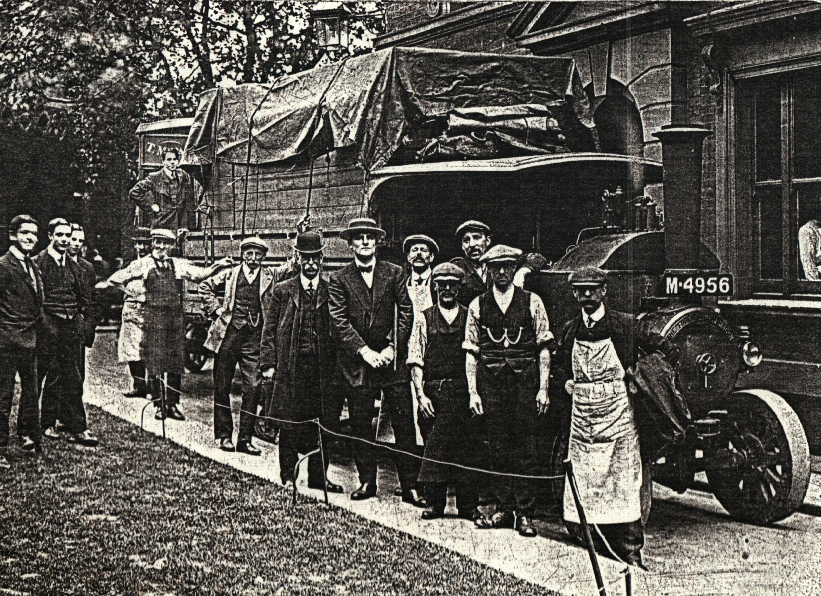
Why were some children’s homes moved out of London to rural areas like Harpenden?
In 1913 the National Children’s Home moved all the children in its London home to a newly built site in Harpenden, Highfield Oval.
REMOVAL FROM LONDON TO HARPENDEN IN 1913, ACTION FOR CHILDREN
Notes:
Teacher input – approximately 20 minutes
Slides 16 to 20 relate to the move of the NCH’s London home out of the East End of London to Harpenden in 1913. The choice to do so happened in the context of concerns about the health implications of overcrowded cities and a growing interest in the benefits of fresh air for children’s wellbeing, demonstrated through the open-air school movement.
https://mediadrumworld.com/2018/08/06/30046/

Slide 18
Why did some children’s homes move out of London to rural areas like Harpenden?
All town dwellers have to have to sacrifice about three-quarters of the sun’s remedial and health-giving energy, whilst those who live in dark, stuffy rooms get hardly any at all. It is estimated that, in the large industrial towns, some six hundred tons of sooty matter, charged with chemical impurities, are deposited every year on every square mile. Those who live at the seaside get twice as much sunshine as those in inland towns, whilst for those high up on the hills the town sunshine is multiplied by three.
The wisdom of setting the Sanatorium on a hill is being justified every day by the enormous advantages to its community of an abundance of fresh air, warmed and purified by the sunlight. Childish faces lose their pallor, appetites improve tremendously, listlessness and languor disappear, and life moves to a happier, brighter measure, with retuning health and energy.
EXTRA FROM ‘THE SANATORIUM, NCH PUBLICATION, EARLY 20TH CENTURY

Slide 19
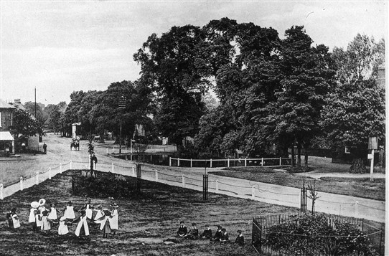
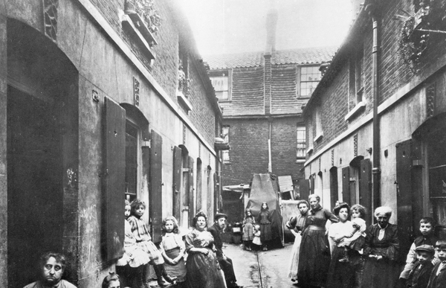
Why did some children’s homes move out of London to rural areas like Harpenden?
CHURCH GREEN AND POND, HARPENDEN 1890s Harpenden History (PRINT 4)
Slum in Victorian London, 19th CENTURY Bridgeman Images (PRINT 5)
Which of these places would you rather live in? Why? Imagine someone had chosen the other picture – what reasons might they give?

Slide 20
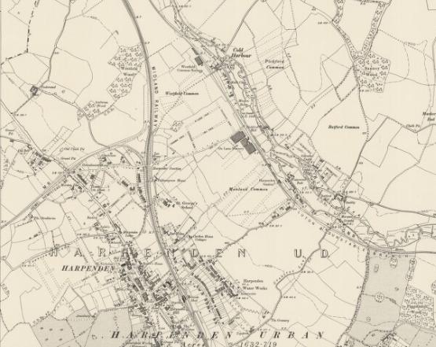
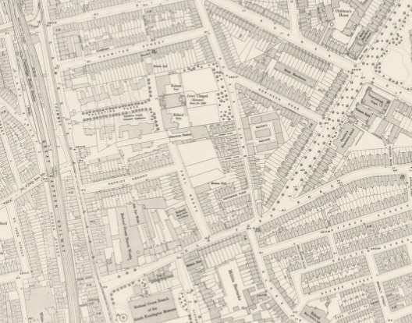
Why were some children’s homes moved out of London to rural areas like Harpenden?
HARPENDEN 1897
BETHAL GREEN 1895
What do these maps tell us the different living conditions in Harpenden and Bethnal Green (the area of London where the children’s home was originally based) at this time?
Notes:
High res versions of these historical OS maps and many more can be access via the National Library of Scotland’s website:
https://maps.nls.uk/index.html
The map of Harpenden is Hertfordshire XXVII.NE and the map of Bethnal Green is OS London 1:1,056 – Sheet VII.38

Slide 21
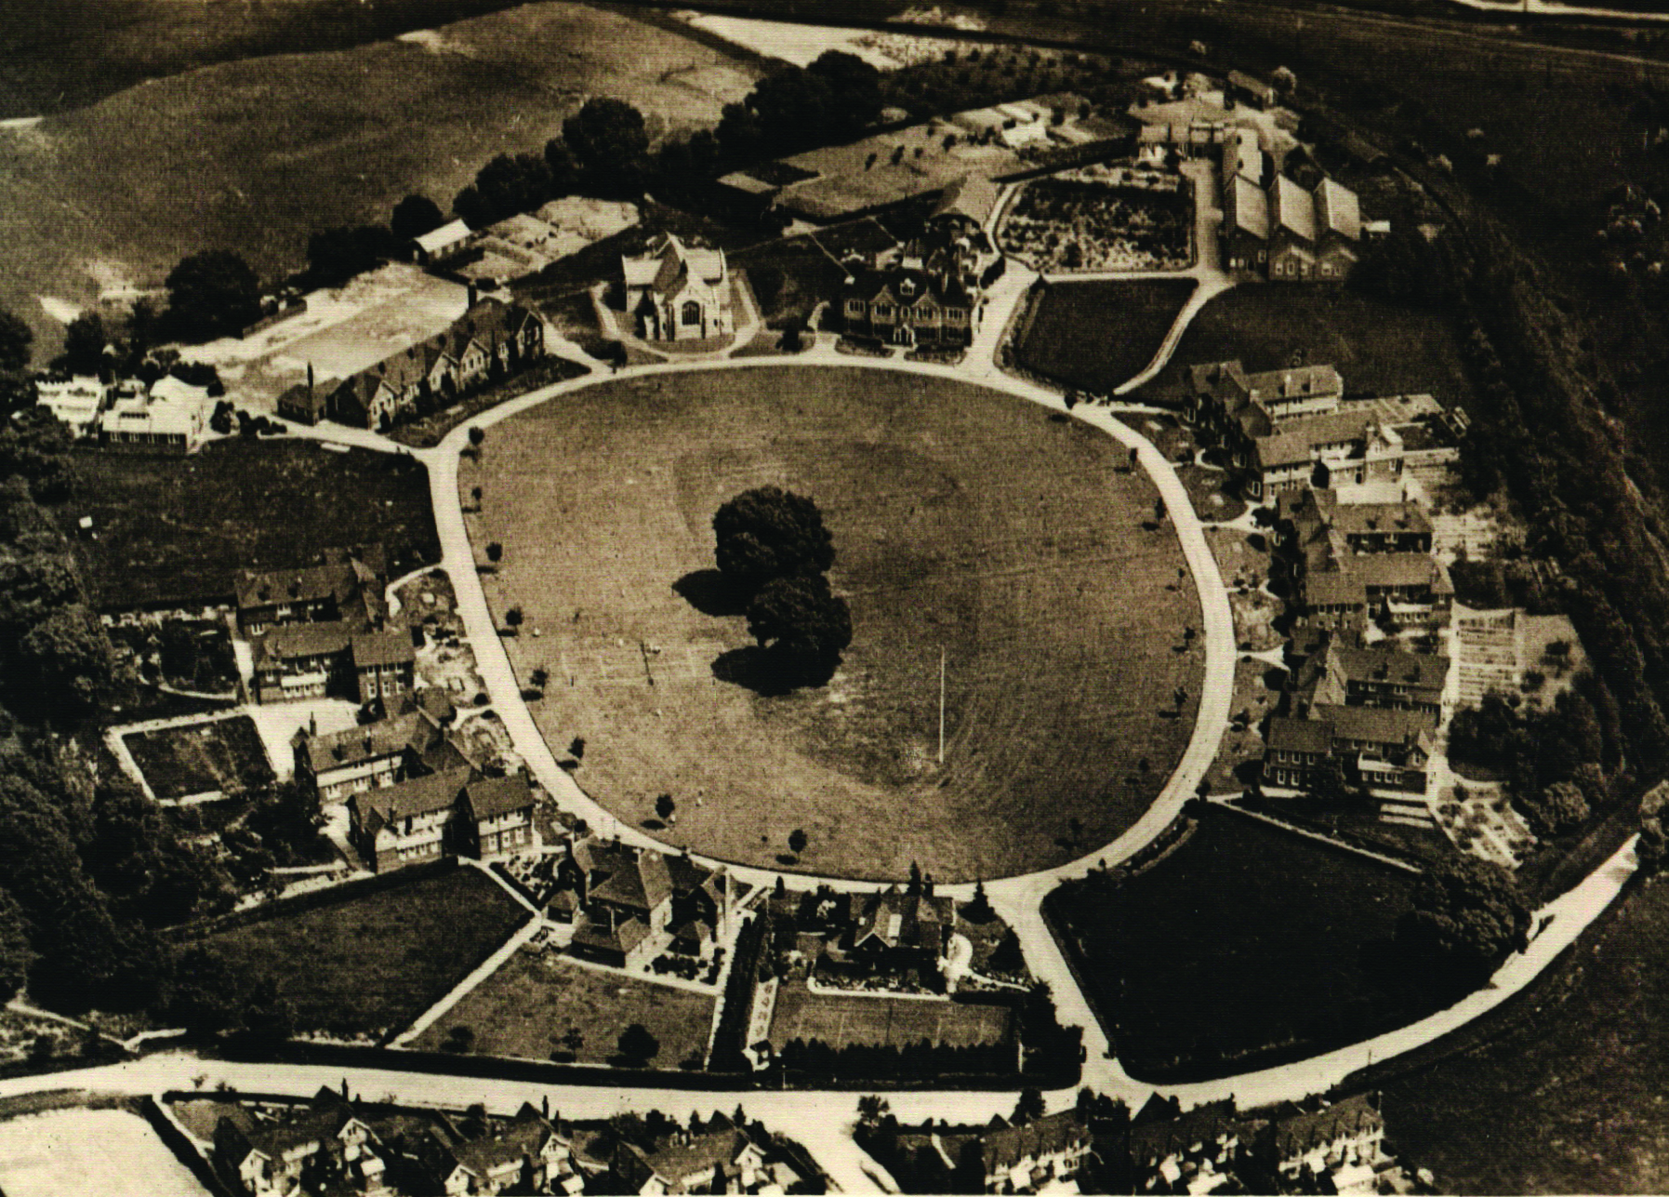
Why were some children’s homes moved out of London to rural areas like Harpenden?
Highfield Children’s Home aerial view, 1920-1930,
action for children

Slide 22
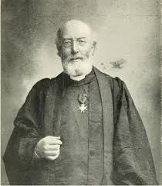
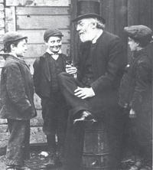
Does change happen because of the conditions of the time, or the actions of individuals?
Look at the pictures of Reverend Thomas Bowman Stephenson who opened the first NCH children’s home.
What do you know about him?
What do you think you know about him?
REVEREND THOMAS BOWMAN STEPHENSON (PRINTS 6 AND 7)
Notes:
Independent activity – approximately 5 minutes
Support children in identifying the difference between what they know (he is a man of the church because of his title and clothes) and what they think they know (deduction and inference eg he is kind because he has a warm, friendly expression on his face)

Slide 23
Is change caused by the conditions of the time, or by the actions of individuals?
Read the biography of Reverend Thomas Bowman Stephenson.
What characteristics made him an effective advocate of change for children?
Who does he remind you of and why?
Might someone else have seen the slums and poor children of London and responded in a different way?
https://www.mymethodisthistory.org.uk/topics-2/action-for-children/thomas-bowman-stephenson
Notes:
Teacher input – approximately 10 minutes
Read the biography to the children and discuss the questions
You could extend this discussion by exploring the life of Octavia Hill (1838–1912) who was also appalled by London’s slums and wanted 'to make homes happy, lives noble and family life good’. Her response was to start running social housing, improving the living conditions for poor families, and campaigning for open spaces, regeneration and clean air.

Slide 24
Reflection
What do you think is the most significant change happening in the 21st century which impacts on children’s wellbeing? Justify your answer.
If you were to be an activist for change, what would you campaign for and why?
Notes:
Reflection – approximately 10 minutes

