Slide 1

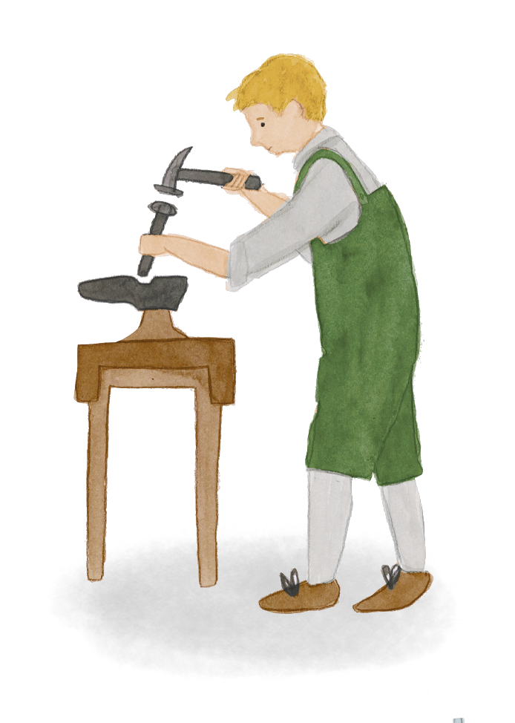

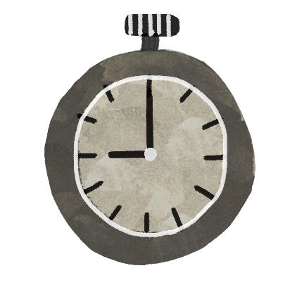
Home and belonging 4
To what extent did the vision become reality at Highfield Oval?
(written sources)
HISTORY

Slide 2

Learning objectives
Learners will be able to:
Select and analyse written sources as historical evidence, taking into account the perspective and purpose of the producer and the context
Explain that no single source of evidence gives the full answer to questions about the past and it is important to cross-reference evidence

Slide 3
Key words
Key concepts | Definition | Synonyms
Vision | A description or picture of what a person or organisation wants to be or achieve in the future.
Founder | Someone who sets up an organisation
Historical source | Something that tells us about the past and can be used by a historian to provide evidence. Documents, pictures, sound recordings, books, films, television programmes, objects or buildings can all be historical sources
Primary source | A source which was written or made in the time period being studied
Secondary source | A source which was written or made after the time period being studied, by someone who did not have first hand experience, by interpreting primary sources
Interpret | describe, analyse, evaluate, and create an explanation of past events
Archives | a collection of historical documents or records providing information about a place, organisation or group of people
Cross-reference | To check a finding by looking at further evidence | Confirm, back up
Perspective | A particular way of looking at or thinking about something, especially one that is influenced by your experiences or beliefs | Point of view

Slide 4
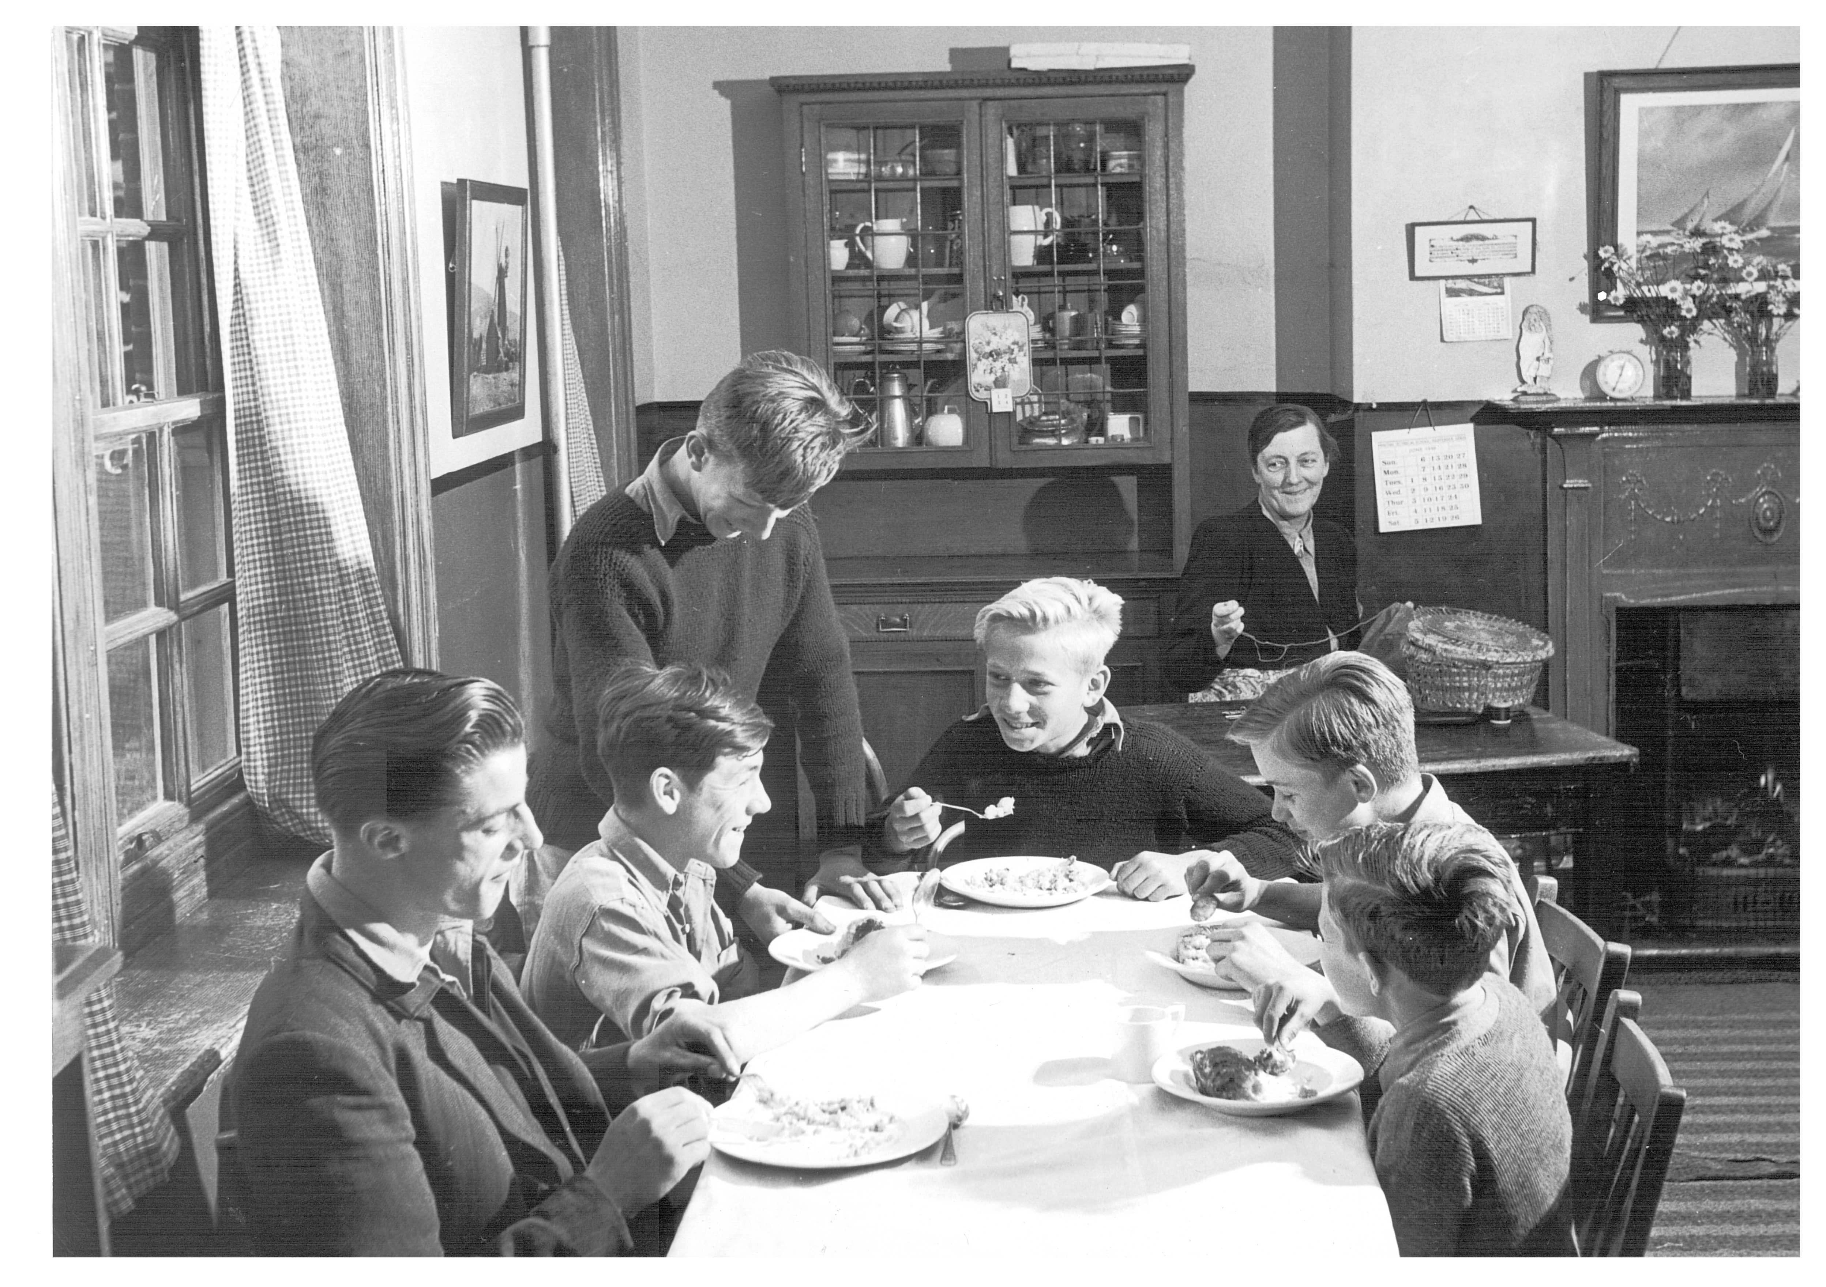
To what extent did vision become reality?

Slide 5
To what extent did vision become reality?
Learning journey so far….
What is the vision?
What does the photographic evidence tell us?
What further evidence would we like to examine?
Notes:
Teacher input – approximately 5 minutes
Recap Highfield vision from last session.
Remind children that last week we looked at photographic evidence and this week we are looking at written evidence eg, diaries, school, records, news reports, council meeting minutes etc
We will continue to find out what live was like for the children living at the Highfield Children’s Home and explore whether or not the founders vision was a reality.

Slide 6
Three corner debate: “The vision for Highfield Oval and the sanatorium was a reality for the children who lived there”
Go to one of the corners of the classroom next to the sign that is closest to your view on this statement so far:
AGREE
CAN’T SAY
DISAGREE
With the other people in that corner share your reasons for your view and then present to the groups in the other corners.
After you have heard the views from the other corners swap corners if you have changed your mind!
Notes:
Engage - approximately 10 minutes

Slide 7
The Friendly Clock
When I first came to Harpenden,
‘Twas on an August day;
No friendly face was there to greet.
No “Hello!” did I say;
But as I walked in through the grates
And gazed across the green,
There on a building was a clock
Whose face was white and clean.
The hands were huge, and painted black,
The figures clear to see:
I wondered if the clock up there
Would be a friend to me.
I had no friend, I’d travelled far
To come to Harpenden,
I was so small and still quite young
To be so friendless then;
And when I’d seen the Governor –
He was so kind and good –
I asked him if I’d like it here
He said he thought I would.
To Deakin then I made my way,
And introduced myself.
The first day there I found so hard,
And walked about with stealth;
A crowd of boys came in from school,
“Our new boy’s here!” they said,
And then that night I couldn’t sleep,
But tossed upon my bed.
I felt so small, it seemed so strange
To live with twenty boys.
I wondered if I should get used
To all their talk and noise.
I used to think about the clock
Whenever I was sad.
And when I saw his friendly face
I felt cheered up and glad.
I went to prayers and then to school,
And soon got used to it;
I saw the Branch and settled down,
And did not mind a bit.
For everywhere upon the Branch,
I saw my friend the clock.
He used to smile and wink at me,
There high up on the ‘’block’.
[….]
So came the day for me to leave,
Eight years I’d been there then.
I’d grown to know that grand old clock
Still there in Harpenden.
And as I passed out through the gates,
I looked back at the ‘block’.
I’d said goodbye to everyone,
Except my friend the clock.
He was still there, and had not changed,
For as I turned to see,
He wished me all the luck he could –
And then he winked at me!
And so to you who follow on,
Who friendless may befall,
Think of a friend you always have –
The clock upon the wall.
The writer lived as a child at Harpenden Oval during the 1930s and 1940s.
Notes:
Teacher input – approximately 10 minutes.
Read and discuss the poem together.
How does the poem make you feel?
What does the poem suggest about life at the Oval for this child?
Do all children in a school/home/family have the same experiences?
Do all children in a school/home/family feel the same way about their experiences?
How reliable is this source of evidence? Why do you think that?
How useful is it in helping us decide whether the founders of the children’s home achieved their vision?

Slide 8
Questions to ask of the written sources
Who wrote it?
What was their perspective?
What does it tell you about life at the children’s home?
What does it not tell you?
Do you think it is reliable? Why?
Is it a useful source? Why?
Does it persuade you that the founders of the children’s home achieved their vision?
Notes:
Independent (slides 8-12) – approximately 30 minutes
The children have 30 minutes to select three pieces of written evidence that they are interested in to analyse in order to make deductions about the past.
Allow the children to choose how they wish to record their findings this week (in the table format or their own choice).

Slide 9
Not a job but a calling
For 27 years I was a Housemother in the National Children’s Home. Consequently I nurtured many more children than most mothers do. Normally I cared for ten children at a time in a family group. All these children came from a wide range of family backgrounds. This was no ordinary ‘job’ but a calling, a way of life, no five day week or seven hour days. No overtime. No bonuses. No profit sharing. My colleagues and I worked happily for six and a half days every week, and sometimes for a full seven days. Each day lasted for a full 24 hours and we were fortunate to get a few weeks annual holiday.
In such a family group one was not only mother but father, teacher, chastiser, comforter, confessor, nurse, cook and chief bottlewasher. No, no I am not complaining, just stating facts. The work was hard physically, mentally and spiritually; it left little time to pray. However, prayer was frequently my only help and comfort. Often one went to bed exhausted and tearful. “Am I inadequate?” was the question on my mind. Johnny had kicked the cat, Jimmy had stolen a pound note, Jenny had been bullying some of the little ones. Where was I going wrong? Without the comfort of prayer I could not have carried on. The next morning all these thoughts had gone and I was ready with God’s help to start a new day refreshed. Do I hear you say “Why did you do this job for 27 years?” The answer is that there were many compensations. There was much love, fun and laughter in the home. There were the lovely days when we took a picnic into the country. The days when we had parties and entertained friends. Children may make you sad at times, but more often they make you laugh.
It is great joy when your ‘children’, after they have grown up and left ‘home’, return with a wife, or a husband and later on as their family grows, their own children and grandchildren. The cry of ‘Auntie do this’ or ‘Auntie look at that’ echoes round the rooms – it is at times like these that one realises that the years spent caring were not wasted.
Sister Anne Pearl was a Sister at Highfield Oval from 1940s to 1960s. She wrote this article for her local church magazine in Plymouth, can be found on the website of the Harpenden and District Local History.

Slide 10
NCH memories, Extract A
I am grateful, too, for the attention given to my physical and medical well-being I mostly enjoyed there, whether I knew it at the time or not. I didn’t, in fact! I remember being particularly prone to coughs, colds, and respiratory problems. (The smog, coal smoke, cigarette smoke, and dampness of England in those days were probably not very helpful either). But all of us children were given daily doses of cod liver oil, orange juice, and malt before leaving for school. Having a hospital on the grounds was also very good because scrapes and cuts and bruises happen wherever there are children playing outside, and I had my share of minor disasters that ended with having to go to the surgery for plasters, bandages, iodine swabs and so on. I spent a lot of time swinging on gym poles, and in the woods, climbing trees, oblivious to the thorns, nettles, wood splinters, rust and insects. Riding bikes and skates around the Oval was a source of much joy, too, and came with the possibility of injuries if you fell. I scrumped apples in the orchard, hiked down to the cemetery on a dare one night with a couple of other girls. I remember one cold morning out in the garden at the back of Ferens, helping to dig a plot for some plants. I was wearing rubber wellingtons that are not very warm or protective, and managed to put a tyne of the pitchfork into a big toe! I didn’t feel it at the time, but when I came to take the wellingtons off in the boot room, there was blood in my boot. Sister Cora hiked me off to the clinic immediately and iodine and plaster was applied. I still have the scar to this day! When I think of it, it’s a wonder I remained in one piece as much as I did.
Shelagh Cosgrove was looked after at the children’s home between 1945 and 1952.

Slide 11
NCH Memories, Extract B
That our physical care and well-being was taken care of is without question. But what of the emotional or psychological needs of children? For me, this is where I feel things feel somewhat short. I know the Sisters and the Staff were good to us, given the understanding of children and their place in those times. The focus was on behavior and there were rules and strict enforcement of them too. This included punishments of various kinds, from having pocket money stopped, free time restricted, having to go to bed early on a beautiful summer evening, and for the boys, being spanked with a slipper, or whipped with a cane. This was all normal in England in those times, even for kids in normal homes, and those expensive boarding schools. The authorities did what they knew—but I feel there was a serious lack of understanding about a child’s emotional needs (especially the trauma of having lost one’s original family, or promises made and broken about visits form members of one’s own family). It became obvious on the forum that some of us shared in more recent times, that these were actually problems shared by many of us. Ways to build self-esteem and autonomy could have served us well for our adult needs later, if there had been some understanding about this.
Shelagh Cosgrove was looked after at the children’s home between 1945 and 1952.

Slide 12
Extracts from punishment book, kept by the managers of the home from 1934 onwards, describing the nature of ‘offences’ carried out by children at the home
Nature of offence
Absconding early morning after being sent to bed for being out of bounds. They wandered to Luton.
Being out without permission on Sunday afternoon.
Being out of bounds and not attending service on Sunday morning.
Was generally breaking rules by going to village without permission.
Absconding for two days without apparent cause other than being pulled up by Sister. Seems to be thoroughly miserable.
Stealing apples and pears from Thompson’s orchard after repeated warnings.
Apple stealing from Home Tree and from gardens.
Out of bounds in girls’ wood. Taking apples from Barlow* trees.
*Barlow was the name of one of the children’s houses at the Oval.

Slide 13
Reflection
Did the evidence you examined today support or refute your conclusion from last week?
Which do you think is more reliable – written or pictorial evidence? Justify your answer.
Which source of evidence most fascinated you? Why?
Which source of evidence was the best example of someone showing kindness?
Which of the scenes you’ve seen or read about would you most want to dive into and why?
Notes:
Reflection – approximately 10 minutes

